Slide 1
Azure Data Factory
[Speaker Name]

Slide 2
Azure Data Factory is a cloud service that orchestrates, manages, and monitors the integration and transformation of structured and unstructured data from on-premises and cloud sources at scale.

Slide 3
Hybrid data integration at scale, made easy
Hybrid data integration at scale, made easy
Create, schedule and monitor data pipelines
Fully managed ETL service in the cloud
Run your SQL Server Integration Services packages directly in Azure
Accelerate your data integration with multiple native data connectors
Modernise your data warehouse with big data integration
Orchestrate your data integration workflows wherever your data lives

Slide 4
Why Azure Data Factory?
Productive
Build automated data integration solutions with a visual drag-and-drop UI. Move data seamlessly from over 60 sources without writing code.
Hybrid
Build data integration pipelines which span on-premises and cloud. Easily lift your SQL Server Integration Services (SSIS) packages to Azure.
Trusted
Data movement using Azure Data Factory has been certified by HIPAA/HITECH, ISO/IEC 27001, ISO/IEC 27018 and CSA STAR.
Scalable
Build serverless, cloud-based data integration with no infrastructure to manage. Take advantage of elastic capabilities to scale out with your customer growth.

Slide 5
What comes with Azure Data Factory?
Visual drag-and-drop UI
Maximise productivity by getting pipelines up and running quickly.
Use the code-free drag-&-drop interface to build, deploy, monitor and manage your data integration.
Connect this visual tool directly to your Git repository for a seamless development workflow.
Multiple Language Support
Use the visual interface or write your own code in Python, .NET, or ARM to build pipelines using your existing skills.
Choose from a wide range of processing services and put them into managed data pipelines to use the best tool for the job or insert custom code as a processing step in any pipeline.

Slide 6
What comes with Azure Data Factory?
SSIS package execution in Azure
Easily execute and schedule your SSIS packages in managed execution environment.
Gain high availability, scalability and lower TCO by lifting your SSIS packages to Azure.
Code-free data movement
Improve your TCO with more than 70 natively supported connectors including Azure data services, AWS S3 and Redshift, Google BigQuery, SAP HANA, Oracle, DB2, MongoDB and many more across multiple global points of presence.
Comprehensive control flow
Facilitate looping, branching, conditional constructs, on-demand executions and flexible scheduling with extensive control flow constructs.

Slide 7
Data Factory Components
Linked Servers
SQL Server Database – PaaS, IaaS, On Premise
Azure Storage – Blob, Table
Datasets
Input/Output using JSON deployed with PowerShell
Pipelines
Activities using JSON deployed with PowerShell
Copy, HDInsight, Azure Machine Learning

Slide 8
Data integration with Azure Data Factory
Step 1: Access and ingest data with built-in connectors
Move data from on-premises and cloud sources to a centralised data store in the cloud for further analysis by using the Copy Data activity in a data pipeline.
Step 2: Build scalable data flow with codeless UI, or write your own code
Build data integration and easily transform and integrate big data processing and machine learning with the visual interface.
Step 3: Schedule, run and monitor your pipelines
Invoke pipelines with on-demand and trigger-based scheduling. Visually monitor pipeline activity with logging and pipeline history and track error sources.

Slide 9
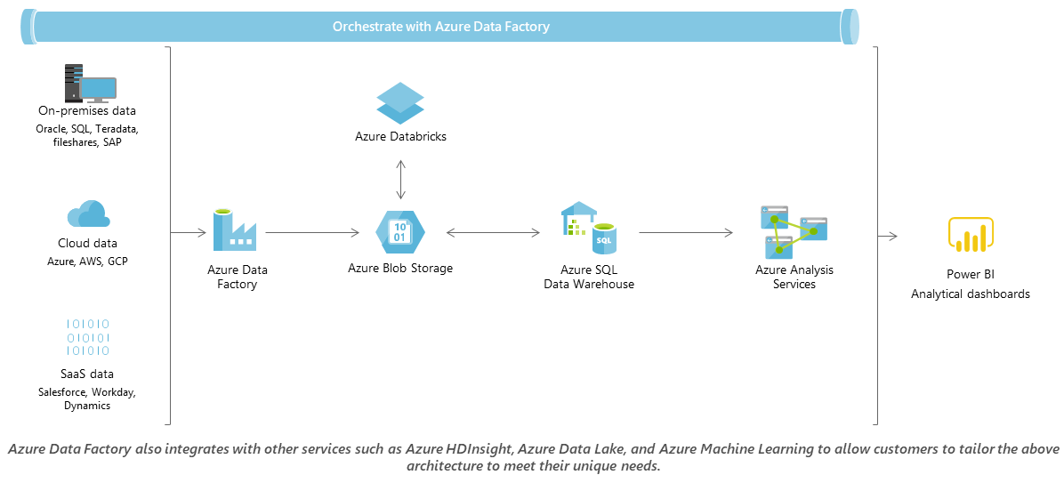
Modernize your data warehouse
aaa

Slide 10
Demo

